Slide 1

Toxic Comments Classification
Presented By:
Esraa Fayad Aya Mahmoud Ahmed Nasser Abdelrahman Ali

Slide 2

Table Of Contents
01
02
03
Data Preparation
Feature Engineering
Problem
04
05
06
Classification
Clustering
Evaluation of Results

Slide 3
Problem Formulation

Slide 4
Problem
The problem of online abuse and harassment is a serious one. It can have a number of negative consequences, including:
Discouragement of participation
Damage to mental health
Increased risk of self-harm and suicide
We trying to build a multi-headed model that can detect different types of toxicity like threats, obscenity, insults, and identity-based hate to handle the effects of this problem.

Slide 5
Data Preparation

Slide 6
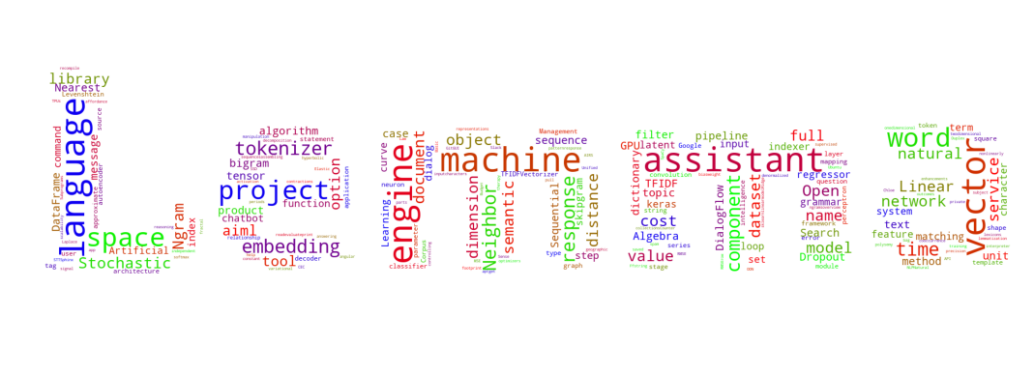


Data Preparation

Slide 7
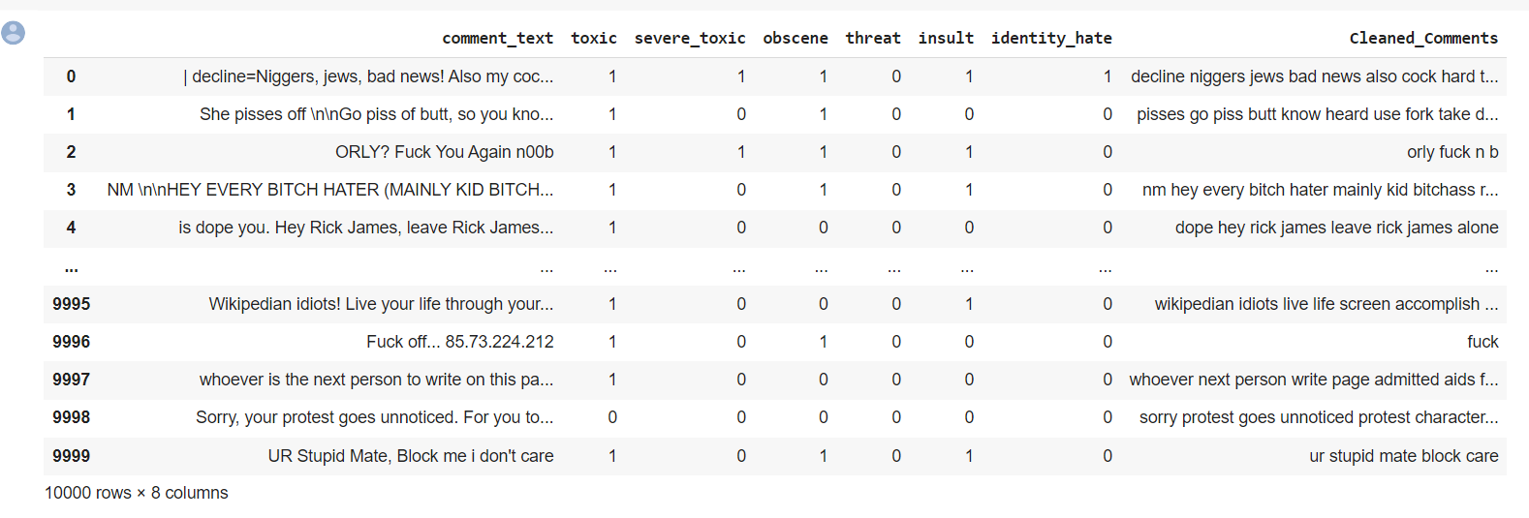
Data Preparation

Slide 8
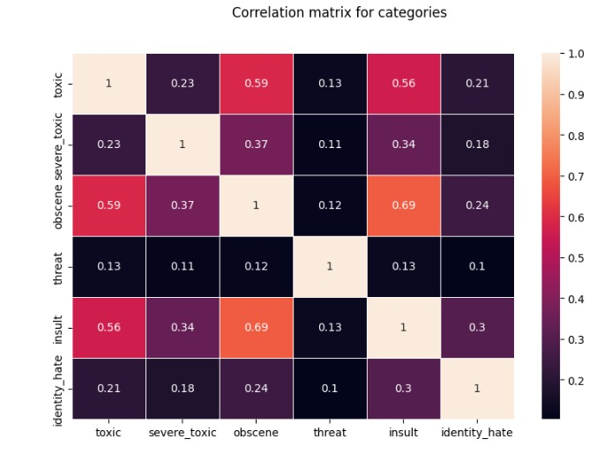
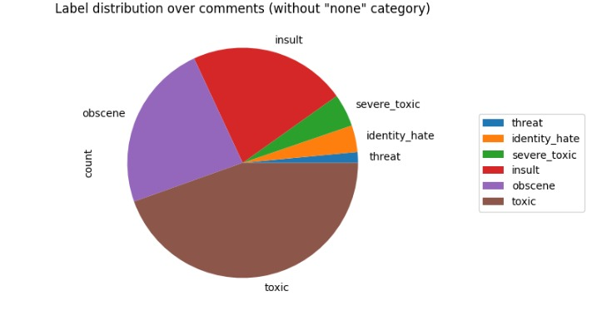
Data Preparation

Slide 9
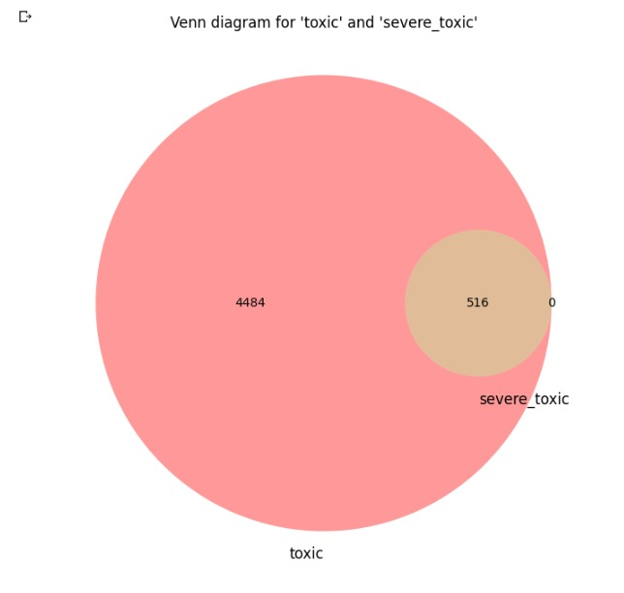
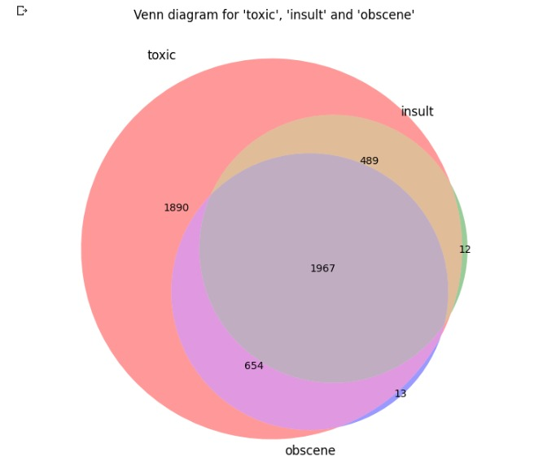
Data Preparation

Slide 10
Data Visualization

Slide 11
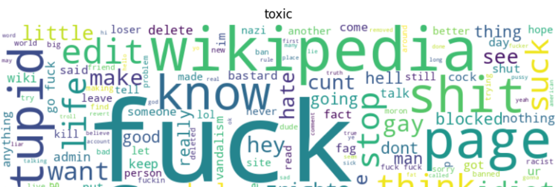
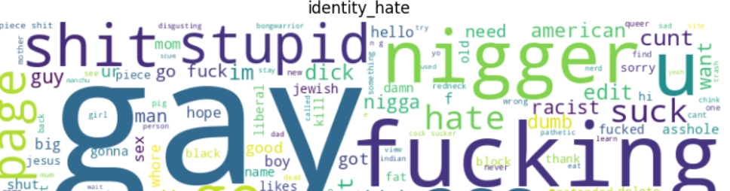
1- Word Cloud

Slide 12
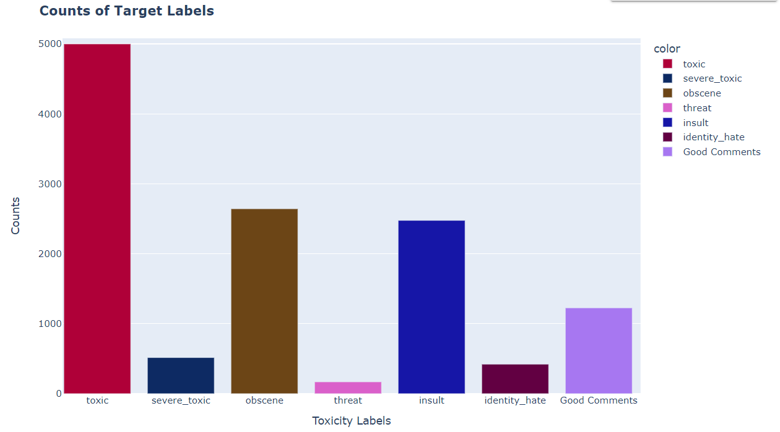
2- Target columns

Slide 13
Feature Engineering

Slide 14
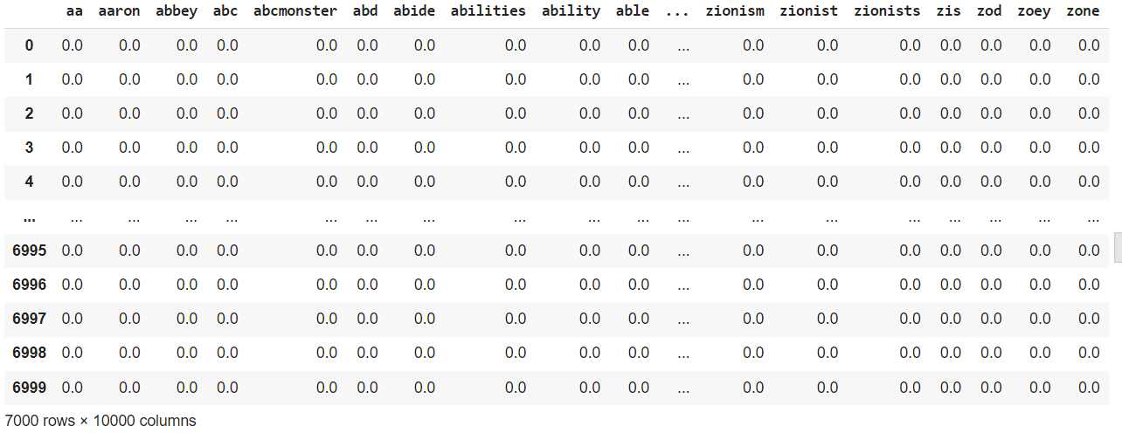
1- TF-IDF

Slide 15
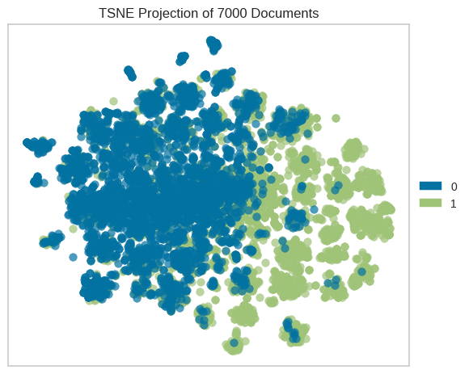
T-SNE of toxic with TF-IDF

Slide 16
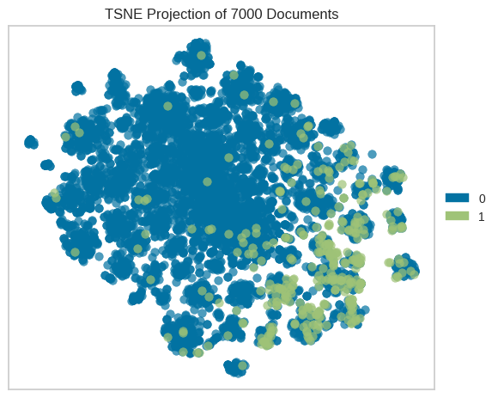
T-SNE of severe_toxic with TF-IDF

Slide 17
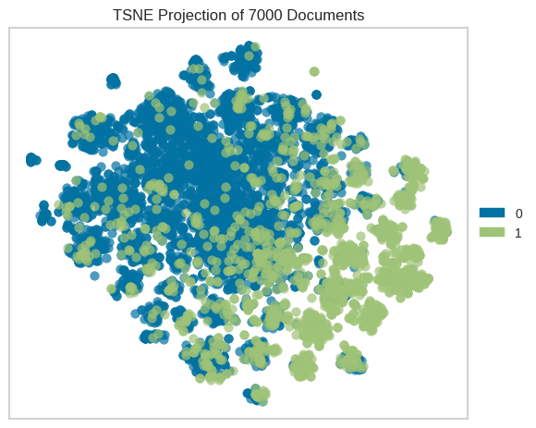
T-SNE of obscene with TF-IDF

Slide 18
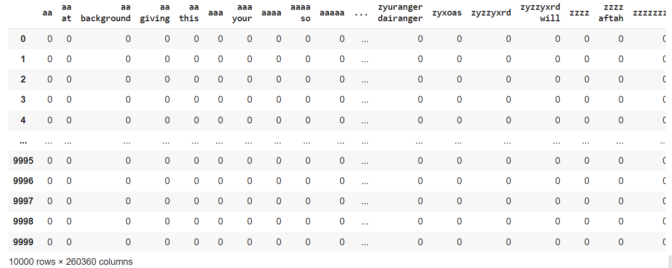
2- N-Gram

Slide 19
Classification

Slide 20
Apply 3 Algorithms
Support Vector Machine
Logistic Regression
XG-Boost

Slide 21
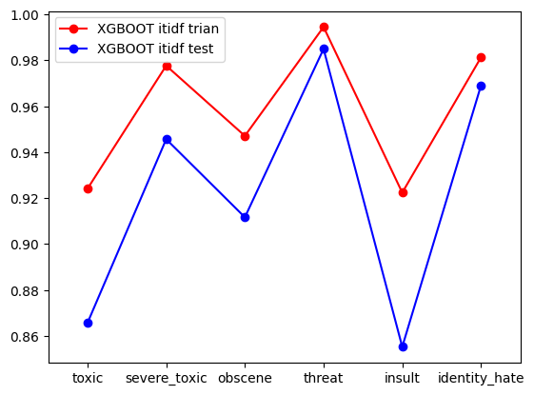
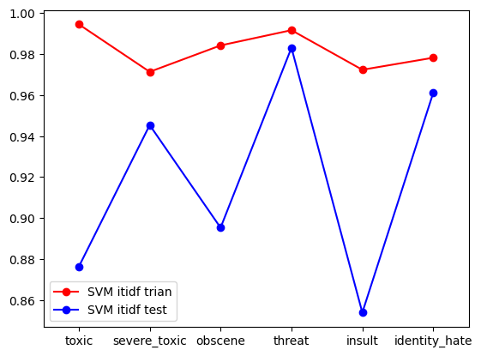
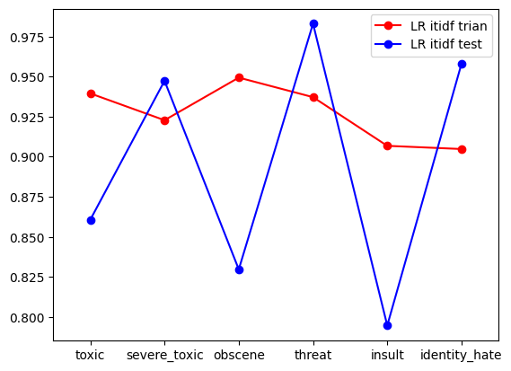
Support Vector Machine
Support Vector Machine
XGBOOST
Logistic Regression

Slide 22
Evaluation of ML Results

Slide 23
Support Vector Machine with TF-IDF
XG-Boost with TF-IDF
Logistic Regression with TF-IDF
Target | Accuracy
Toxic | 87%
severe_toxic | 94%
obscene | 89%
threat | 98%
insult | 85%
identity_hate | 96%
Target | Accuracy
Toxic | 85%
severe_toxic | 95%
obscene | 82%
threat | 98%
insult | 80%
identity_hate | 96%
Target | Accuracy
Toxic | 86%
severe_toxic | 94%
obscene | 91%
threat | 98%
insult | 85%
identity_hate | 96.9%

Slide 24
Champion Model
The champion model is XG-Boost based on testing accuracy for each target.

Slide 25
Error of Analysis

Slide 26
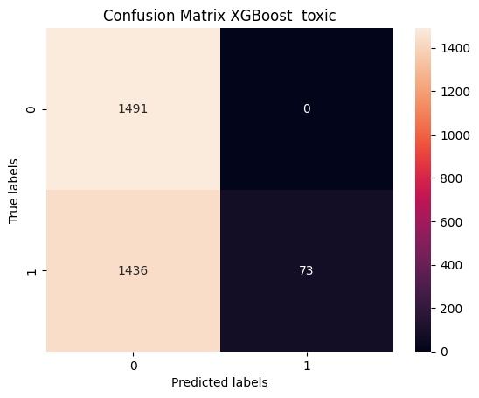
XG-Boost with TF-IDF for Toxic target
We decrease the number of the partitions and the size of each partitions due to size of memory.
When we applied XGBoost to classify text as either toxic or not toxic. The model classifies a sample as positive when it is actually negative and the model classifies a sample as negative when it is actually positive.

Slide 27
Clustering

Slide 28
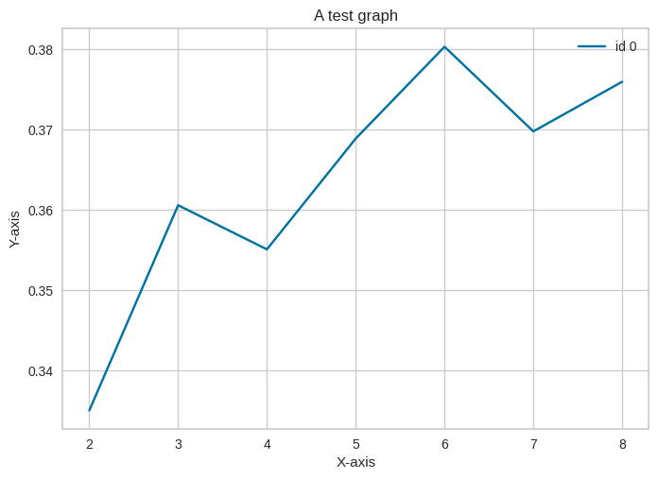
K-means with BOW

Slide 29
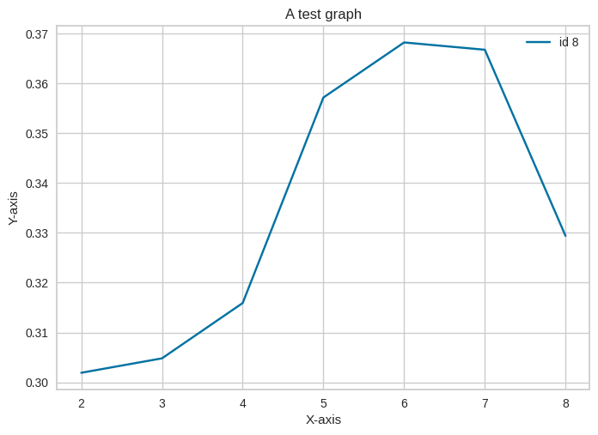
K-means with TF-IDF

Slide 30
GUI

Slide 31
Result

Slide 32
Thanks!

